Slide 1

Project presentation on
SATELLITE COMMUNICATION FOR 5G: PROMISING YET CHALLENGING
Presented by:
Susmitha Neerubai
WSU ID: C534C335
5G wireless communication

Slide 2
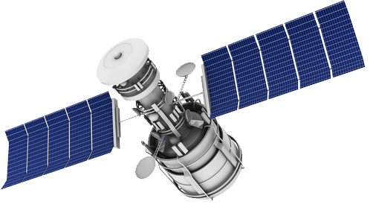
PAPER BASED ON:
THE FOLLOWING PRESENTATION IS BASED ON THE TOPIC "Satellite communications for 5G – Promising yet challenging.”
AUTHORS: Ning Wang, Chang Ge, Barry Evans, Yogaratnam Rahulan, Michael Fitch.
PUBLICATIONS:
IEEE Wireless communication ,
IEEE communications society (IEEE ComSoc),
Communications Technology news (CTN)

Slide 3
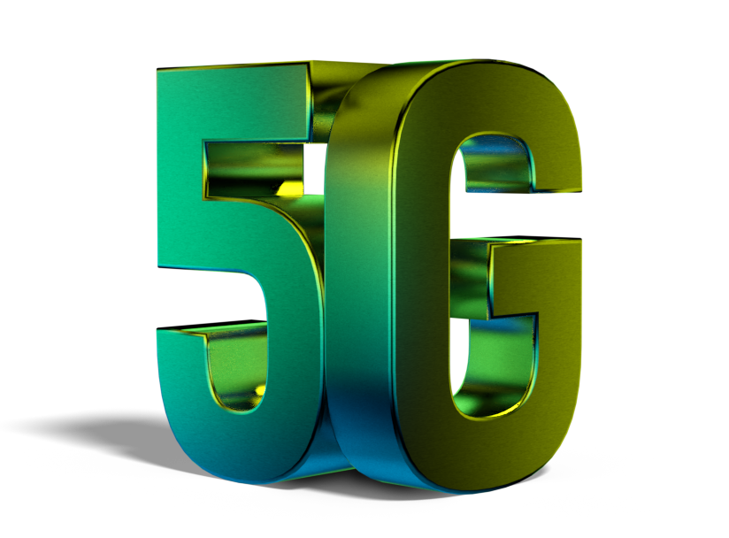
INTRODUCTION TO 5G:
Today, we are on the verge of seeing what a truly “connected world” looks like.
It’s projected that soon there will be 6 billion people, 30 billion devices and 50 billion machines online.
That’s essentially everyone and everything connected, across every geography, supporting every application from consumer broadband, mobile gaming and connected cars to global business networks, ships, planes, soldiers, first responders and connected farms.

Slide 4
MOTIVATION of 5G & SATELLITE COMMUNICATION:
Supporting a connected world is a daunting challenge that today’s telecom infrastructure is simply not equipped to handle.
5G have exponentially higher efficiencies, massive scalability, significantly lower costs for mobile and fixed networks, and ultra-low latency applications such as connected car and massive M2M and IoT applications.
5G will enable new types of applications and services in different domains, and satellite communications will be an essential part of the 5G infrastructure.
We believe the opportunities for satellite are enormous. Mobile network operators will be able to complement their 5G services with satellite connectivity to offload their terrestrial networks in a large scale with satellites.

Slide 5
CONTEXT OF 5G IN SATELLITE COMMUNICATION
Traditionally, satellite communication has remained standalone and separated from the technical domain of mobile networking. It hasn’t been until recently that efforts have been made to embed satellite communication as an integral part of the 5 generation (5G) mobile networks.
As such, 5g will dramatically change how satellite is integrated into mainstream, achieving full interoperability within the end-to-end 5g network. With 5g, the satellite network will be developed from the get-go to interoperate within a 5g architecture.

Slide 6
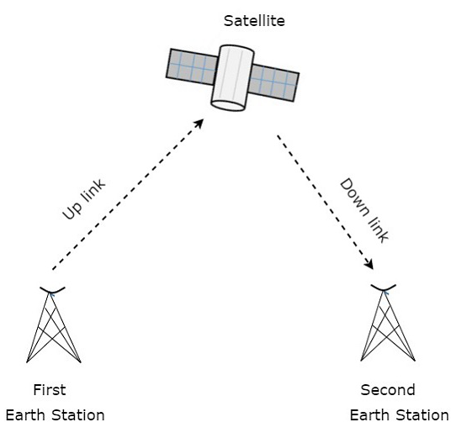
Working principle: Once satellites placed in the space two forces acts on them. They are Centripetal force and centrifugal force. The centripetal force is due to earth’s gravitational pull and centrifugal force, pushes satellites away from earth. This two forces must be equal and precise in order to orbit earth. They mismatch between this two forces results destroying the satellite
CURRENT SATELLITE SYSTEMS

Slide 7
Objectives:
As satellite provides supreme features such as globally reachable connection, huge amount of data can be distributed in any region and synchronized delivery.
Those features bring lot of services like TV broadcast, broadband access, massive IoT, higher mobility and ultra-reliable communications.
5G provides also the ultimate opportunity for the satellite industry to offer a much wider range of services, while enabling mobile and fiber operators to leverage satellite connectivity to expand their coverage areas.
To meet the growing demand for GBPS rate.
To accommodate more users.
To increase data rates anew radio propagation technique is been introduced into future 5G cellular network.

Slide 8
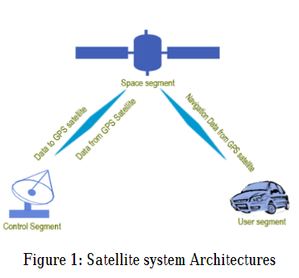
Architecture of satellite systems:
Current studies say that in space segments, there are 24+ satellites or SV’s (Satellite Vehicles) orbiting the earth.
Nowadays more than 30 operator’s satellites are on orbits. The SV’s are orbiting with a radius of 26,560km and at a certain on earth there are 4 satellites are visible. Main task of space segments is generating and send ranging signals. In control segments have different task such
as monitoring and maintaining satellites orbits, satellites health and GPS time. Users segments are basically user’s receiver devices for position, velocity and time solutions
GPS satellite have Transmission frequencies of L1 = 1575.42
MHz = 154 x 10.23 MHz and
L2 = 1227.6 MHz = 120 x 10.23 MHz
There are two basic GPS signal codes available, namely C/A
codes and P(Y) codes.

Slide 9
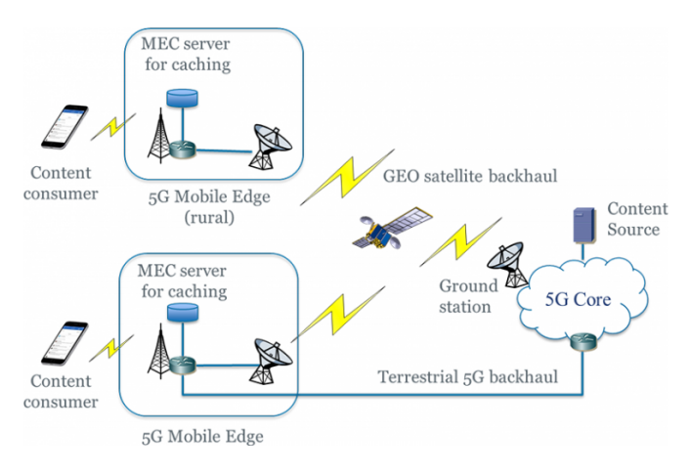
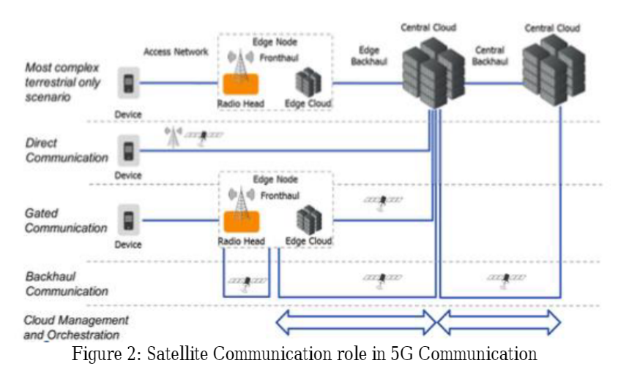
METHODS
1.GEO satellite link – delivers offline
GEO satellite link connects the central 5G core network and multiple remote 5G mobile edges.
In rural areas satellite may be the only backhaul option but also in other areas satellite can still be used in conjunction with terrestrial means.
In content delivery networks the role of satellite can be to offline deliver (popular) content to the mobile edge. As such, local users will be able to access the pre-cached content at the attached MEC server, thus leading to the reduced content traffic volume through the 5G core.
2. Backhaul segment:
Backhaul segment of the network is the most promising role in 5g satellite communication tool.
Strong backhaul satellite communication can be helpful for M2M solutions, mobile computing
and maintaining virtual machines. There are other futuristic usages of satellite communication in 5g are satellites can communicate directly with user terminal.

Slide 10
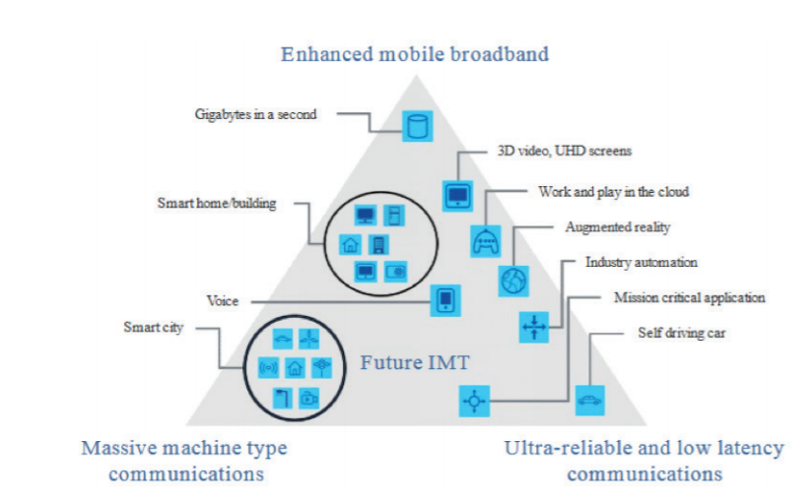
5G Applications and satellite role:
1. Enhanced mobile broadband (EMBB):
Offers vastly enhanced and faster broadband connectivity to WAN , hotspots.
5G to premises: Satellite compliment to terrestrial networks.
5G to Backhaul : Satellite brings broad band connectivity where it is difficult to set up terrestrial connections in rural and remote areas.
5G mobility backhaul : connectivity to remote or airplanes, trains, vehicles .

Slide 11
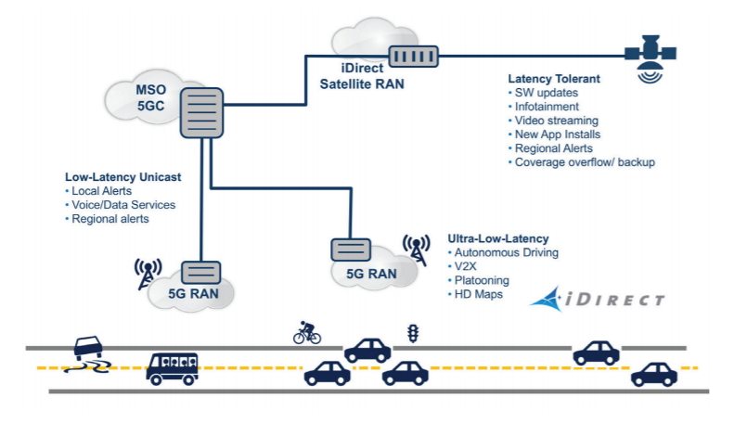
2.Ultra reliable and low latency communications (URLLC):
Important for mission – critical real time applications
Ex as shown in the fig : consider case of autonomous cars where latency is critical. To establish a successful communication , cars need to talk to each other within milli seconds. After the 5G has been introduced , autonomous driving with low latency possible.
3. Massive machine type communications (MMTC):
This is IOT devices. Here software defined networking plays a crucial role.
Enables several UE to be serviced with the equivalent resource of single 4G UE.
The the 5G architecture connects and backhauls the data from million of smart devices and sensors etc.

Slide 12
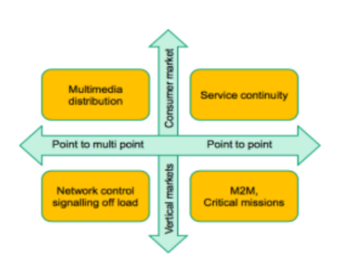
Applications of Satellite Communication
multimedia distribution- Content providers are usually broadcast their tv programme via satellites. Live sports match or live tv shows with high speed internet is prime demand in this sector.
service continuity - describes that in remote places of the world can be accessible via satellite communication in 5G. Helps billions of devises to connect with wide range of connectivity.
network control and signalling offload - As the 5G is based on large number of small cells or network densification is key so there will be huge amount of signalling data going to be sent to the network. Using 5G satellite communication this signalling can be reduced.
M2M and critical missions.

Slide 13
VERIFICATION &RESULTS:
On further studying the feasibility of transmitting HLS (HTTP-based Live Streaming) based live streaming content with Ultra-high definition (UHD) 4K video at a bitrate of 20Mbps through the satellite-backhauled 5G network infrastructure, with a conventional end-to-end delivery scheme, it has been verified that the user experiences were extremely poor due to the limited TCP throughput incurred by the satellite link latency.
However, the project team have designed and developed a MEC-enabled scheme to break the end-to-end connection with a transient video segment holding technique at the mobile edge, the playback performance has substantially improved with the complete avoidance of streaming disruptions.
Adapting satellite to work seamlessly with 5G cellular and terrestrial networks will empower end users anywhere in the world with consistent, reliable, high performance experiences. Service providers will be able to decide how they can best serve customers — whether it’s through satellite, terrestrial or mobile networks, or all of them combined.

Slide 14
Advantages:
Mobile network operators offload their terrestrial networks in a large scale.
Taking advantage of satellite inherent multicasting/broadband functionality , but preserves high value wireless spectrum for latency sensitive services.
satellite’s inherent multicasting/broadcast functionality for new use cases, such as connected car, while preserving high-value wireless spectrum for latency-sensitive services. Or, they can use satellite’s longer range to complement the buildout of 5G in remote areas where building terrestrial networks for enhanced broadband services is simply too cost prohibitive.
Disadvantages
Resource optimisation on parallel backhaul links - Given that satellite communication offers an additional channel for carrying trac over the 5G backhaul, context-aware policies or mechanisms need to be in place to properly steer trac through either the satellite or the terrestrial backhauls.
Holistic orchestration of network functions : partly depends on how the SNO networks support the MNO networks and partly on the virtualization architecture underlying the SNO networks.
Further complexity in the business model

Slide 15
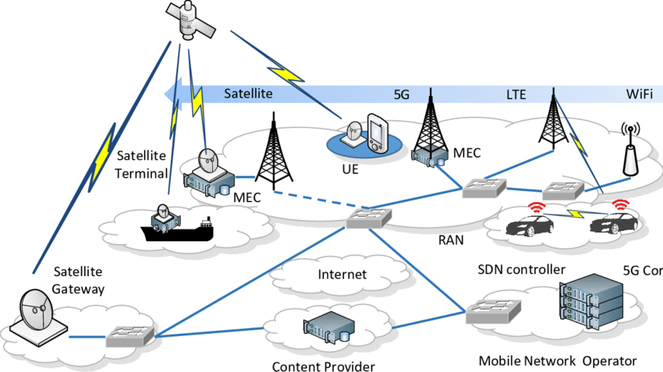
Conclusion
It is still required to work on this satellite communication in 5G. The network providers, vendors and operators of 5G communication related company can search more use cases and other solutions for the betterment of this. There are different companies nowadays also working on the same point for bring something tangible.
Integrated satellite – terrestrial architecture

Slide 16
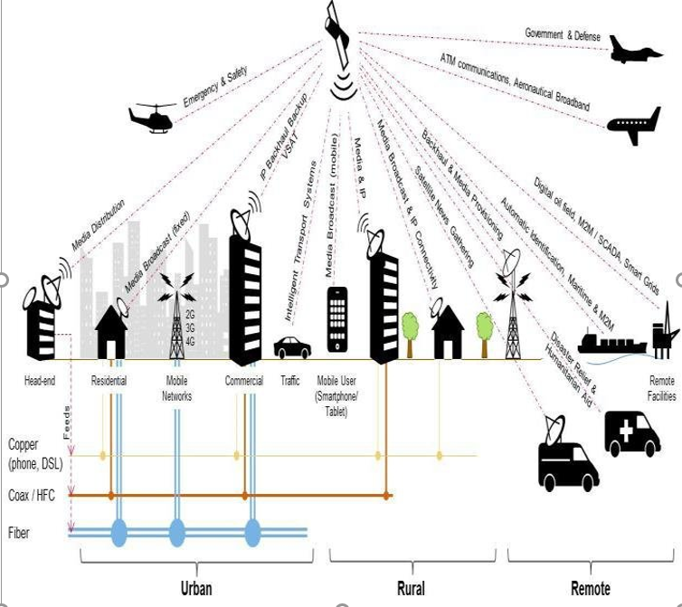
Future methods:
Satellite can no longer be a separate, standalone network. Rather, it must become a standard radio interface within the multi-radio network architecture of 5G.
In the future, an intelligent 5G network will need to automatically engage satellite — quickly and easily.
our industry will shift from a peripheral position in the global communications infrastructure to a central player in achieving a truly connected world.
Service providers will be able to decide how they can best serve customers — whether it’s through satellite, terrestrial or mobile networks, or all of them combined.

Slide 17
References:
file:///C:/Users/c534c335/Downloads/5GSatellitecommunication.pdf
https://www.idirect.net/wp-content/uploads/2019/01/The-5G-Future-and-the-Role-of-Satellite-White-Paper-2019.pdf
https://www.researchgate.net/publication/315779579_Satellite_Communications_in_5G_Context

